Slide 1
Big Data Architecture and Governance Individual Project – MetLife
Supriya Murty
NUID- 001431577

Slide 2
Company Name: MetLife
Industry: Insurance: Life, Health (stock)
History/Background: Organized by a group of New York City businessmen in 1863, the National Union Life and Limb Insurance Company began business in July 1864 insuring Civil War sailors and soldiers against wartime-related disabilities. National Union had written only 17 life and 56 accident policies, and was in last place among the 27 life companies operating in New York.
After five difficult years in business and several reorganizations and name changes, President James R. Dow and the board of directors decided to drop the casualty business and focus on life insurance business. And this gave birth to Metropolitan Life Insurance Company(MetLife).
This new venture also faced difficulties as there were policy lapses over successive years which forced the company to contract until it reached its lowest point in the late 1870s.
In 1879, MetLife President Joseph F. Knapp turned his attention to England, where "industrial" or "workingmen's" insurance programs were widely successful. American companies had not bothered to pursue industrial insurance up to that time because of the expense involved in building and sustaining an agency force to sell policies door to door.
By importing English agents to train an American agency force, MetLife quickly transferred successful British methods for use in the United States. By 1880, the company was signing up 700 new industrial policies a day. Rapidly increasing volume quickly drove down distribution costs, and the new program proved immediately successful.

Slide 3
Organization Issues
Project Name: Customer Service Breakthrough
Project Name: Customer Data Record
MetLife wanted to build the proverbial 360-degree customer view but failed, with disparate systems and data being the usual culprit in failed attempts to gain a consolidated customer view.
However after choosing a Big Data Technology as the platform for bringing together data from more than 70 separate administrative systems, claims systems and other data sources, they were on the path of success.
The choice of Big data for the project makes sense because these databases can ingest large volume and variety of structured, semi-structured and unstructured information without requiring tedious, expensive and time-consuming database-mapping or extract, transform and load (ETL) processes to normalize all data to a rigid schema, as required by relational databases.
Lately, MetLife recognized that it is not easy to live with a disease like diabetes and were looking for technologies that will make it easier for customers to record their health data and, by extension, manage their disease more easily and effectively.
They wanted to achieve this to make medical protection more accessible to this group of people.
MetLife in Hong Kong is using big data to analyze the behavior of customers to determine their premium, and customers with a more healthy lifestyle can enjoy lower premiums than those who do not.

Slide 4
Project Selection Summary
Project Name: Customer Service Breakthrough
Project Name: Customer Data Record
Consolidated one view of and millions of data from various systems.
Results in better ranking in the market once implemented.
Better ROI .
SWOT Analysis showed better results for this project as it has much better scope.
Worldwide project, Resulting in Global economy.
Although money involved is very high it has much better returns in the future.
Promising results with better opportunities and strengths
Carried out on a local scale for a particular country like Hongkong.
The project is already in process, but not received the result yet.
Cost Of not implementing is higher even though it is being implemented on much smaller scale.
Just a Test Project as one with a data record is already present with MetLife.
Lot of resource and budget is involved on a smaller scale.
Weakness involved with project might effect the project development.

Slide 5
Functional Requirements:
This project will help the company to gather data records from across the world and store it in a single platform.
To visualize a Consolidated and integrated Customer view.
To access data from different directories and systems like administrative systems, claims systems and other data sources.
To simplify the rigid and time consuming data mapping and ETL Process.
Ability to normalize data into a rigid schema.
The application must be able to scrape the unwanted data and format the data in such a way that all the customers records across the globe can be viewed into a single view.
It is important to authenticate via, encryption, session management, passwords, etc.
Not every employee has access to every part of the project. There is a necessity to authorize users of the project by providing privileges and allowing access to parts of project they need to work on.
To meet the proper licenses and certificate requirements to the start of the project.
Perform data integrity checks on regular basis.

Slide 6
Non Functional Requirements
Performance requirements : Response time is improved by using a NoSQL database and provides a complete timeline of customers’ transactions – claims, records, status, etc.
Platform constraints : The choice of NoSQL for the project makes sense because these databases can ingest structured, semi-structured and unstructured information.
Modifiability: Data Requirements from all the data sources needs to be modified and manipulated into a single customized view.
Throughput: Achieving high throughput by performing transactions globally and customer data output at global level.
Privacy: High end data security is achieved using a NoSQL data base and all the transactions are secured and acid compliant.
Scalability: Scalability must be achieved both horizontally and vertically. The model should be able to work with large data.
Recoverability: Maintaining logs, taking backups should be performed. System should be robust and fault-tolerant
Maintainability: Building system design, ensuring the ease, accuracy, safety, and economy of maintenance tasks within the project is handled under maintainability.

Slide 7
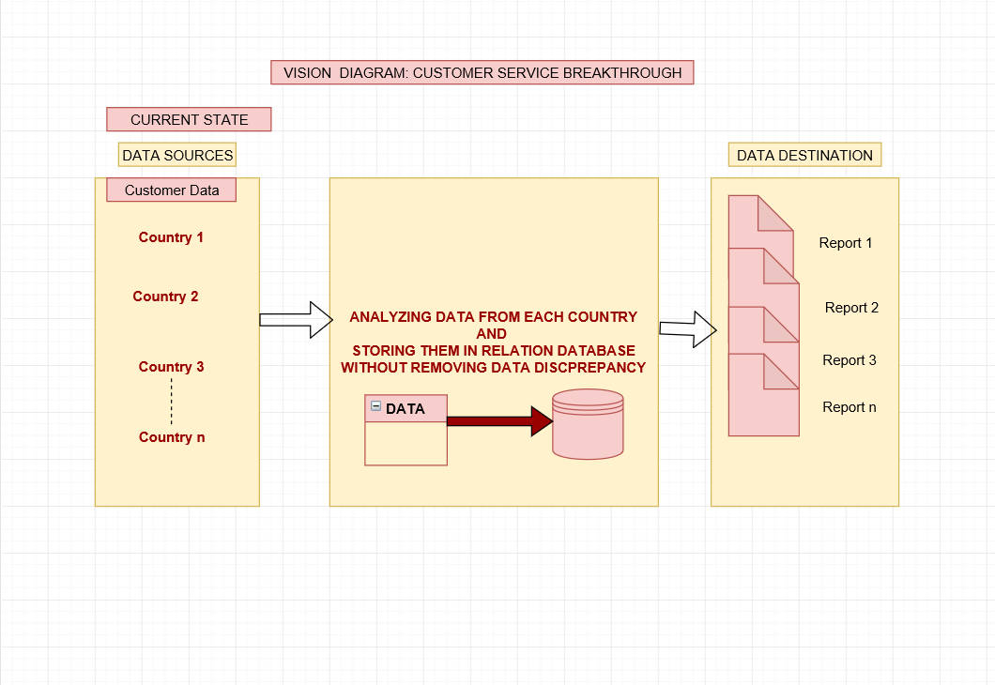
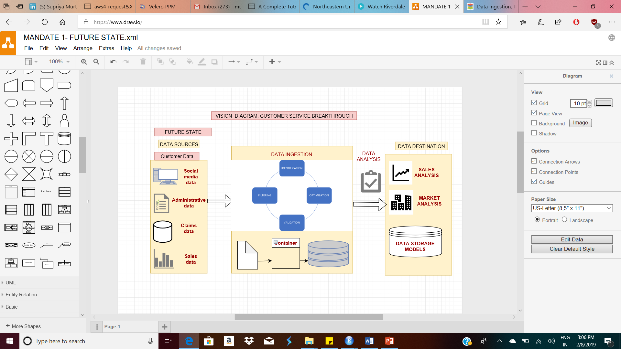
Vision diagram: CUSTOMER SERVICE BREAKTHROUGH
CURRENT STATE
FUTURE STATE

Slide 8
Architecture:
Data architecture can be broken down to four major layers.
Framework
Database
Visualization
Language and management tools
The data architecture that can be used to achieve the 360 degree consolidated customer view on the basis of the above vision diagram is segmented into following layers:

Slide 9
Continued..
Framework-Hadoop
Hadoop framework provides the best outcome in order to achieve the 360 Degree consolidated customer view.
The vision diagram is divided into the 3 main layers namely,
Source layer
Corporate data warehouse layer which is further broken down into:
Acquisition layer
Atomic layer
Transformation and access layer
Destination layer – BI abstraction and reporting layer
MetLife takes personalization to a new level with MetLife Wall as it puts all related and linked customer information into a single Facebook-style historical record. The application provides a single screen with all the necessary information to quickly and easily serve MetLife clients.
Here as the data involved is very large and Hadoop framework provides the best result when dealing with large chunk of data , for storing and processing large volumes of data distributed across a cluster of commodity servers and commodity storage.

Slide 10
Continued..
Whether improving customer service, supporting cross-sell and upsell, enhancing business efficiency or reducing risk, MongoDB and Hadoop provide the foundation to operationalize big data.
Data Ingestion
Distributed processing framework like “SPARK”
DATA SOURCES
Message queue
Mongodb
Processed data
Batch processing & views
Extraction& staging
cleansing
Normalization & storage
Transformation and performnace
Raw data
HADOOP HDFS

Slide 11
Continued..
Data from the various data sources are ingested to a pub/sub message queue, which routes all raw data into HDFS. Processed events that drive real-time actions, are routed to MongoDB for immediate consumption by operational applications.
Distributed processing frameworks such as Spark then materialize batch views from the raw data stored in the Hadoop data lake.
MongoDB exposes these models to the operational processes, serving queries and updates against them with real-time responsiveness.
The distributed processing frameworks can re-compute analytics models, against data stored in either HDFS or MongoDB, continuously flowing updates from the operational database to analytics views.
The analytic views can be achieved through interactive dashboards, web reports, Ad-hoc reports and analytics.
The interface keeps a record of all the past interactions each customer may have had with MetLife across all its omni-channel touch points, such as the call center , in-person interactions with agents, as well as claims and policy updates.
Since the software platform provides a complete timeline of customers’ transactions – claims, records, status, etc., it also enables MetLife’s agents to quickly retrieve and cross-sell solutions which is the aim behind the project.

Slide 12
Continued..
Database-MongoDB
The consolidated view brings together data from more than 70 legacy systems and merges it into a single record. It runs across six servers in two data centers and presently stores about 24 terabytes of data. That includes MetLife’s entire U.S. customer base (some 45 million agreements in total), although the goal is to expand it to international customers and multiple languages, as well, and maybe even create a customer-facing version.
Why MongoDB?
Everything we know about a customer and everything we know about a policy can be stored into a single JSON [Java Script Object Notation] document ."Any other database wouldn't allow to view customers as a single record without caring about structure at all. With Mongo, we can bring a group policy and an individual policy together without any [data] normalization, and we use a Web services layer and the application to render the best view of that data."

Slide 13
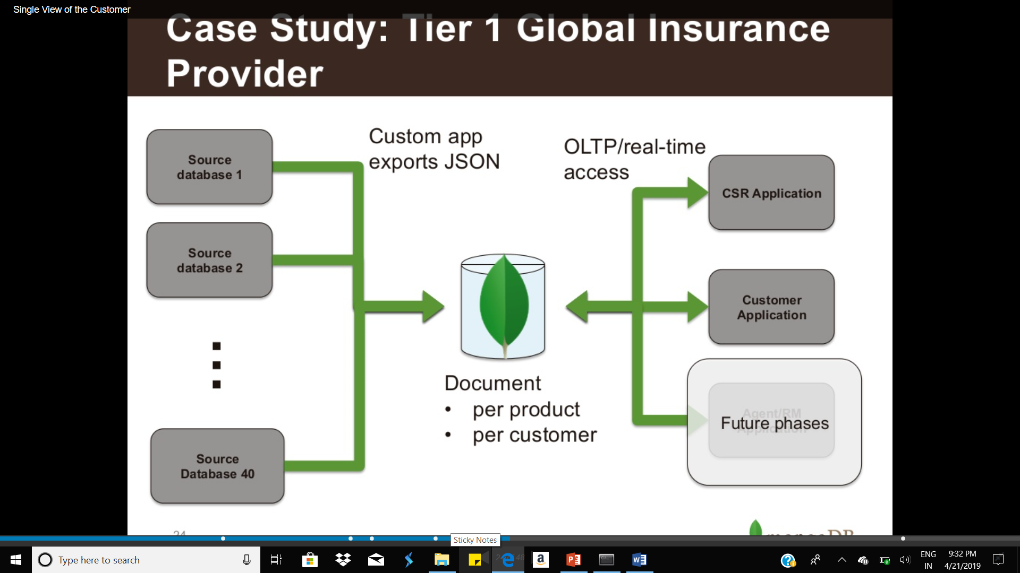
DataBase
MongoDB Architecture that can be build to achieve consolidated view:

Slide 14
Continued..
MongoDB helps because:
Dynamic schema: can handle vastly different data together and keep improving and fixing issues over time easily.
High scale/performance- directly impacts customer experience or CSR MTTR SO every seconds count
Auto- sharding- can automatically add processing power as customers and insurance and other products are added.
Rich querying- supporting ends users directly requires multiple ways of access and key/value is not sufficient
Aggregation framework- database- supported roll-ups for analysis on data hub for customer information .

Slide 15
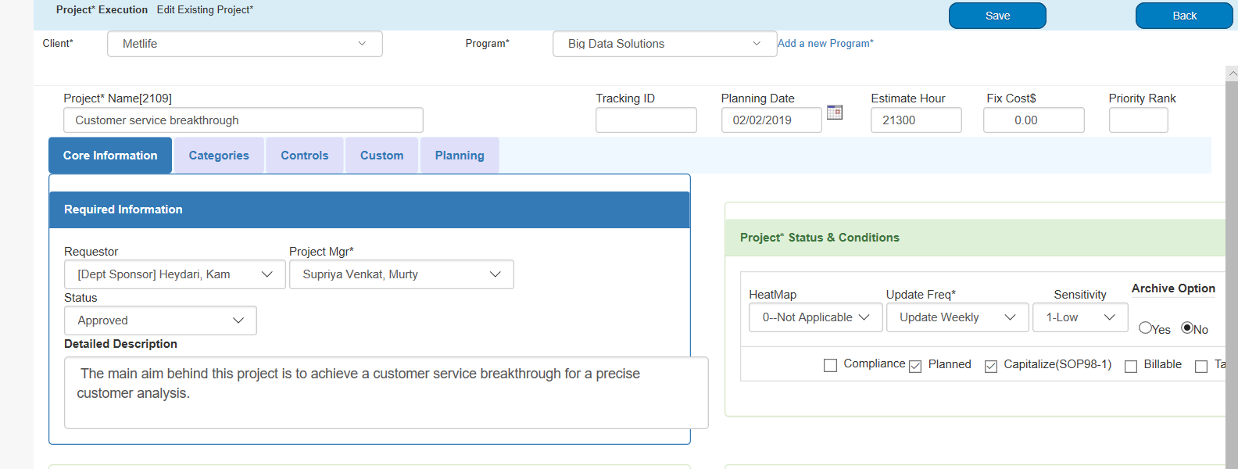
Project Plan
STEP 1
The foremost thing was project selection on the basis of the swot analysis, Risk factor and budget allocation and time required for project completed, total investment and some other factors.

Slide 16
Project plan-Timeline sheet
TASKS | START DATE | END DATE
PROJECT AIM | 1/12/2019 | 1/15/2019
GOAL | 1/16/2019 | 1/19/2019
REQUIREMENT GATHERING | 1/21/2019 | 1/28/2019
RESOURCE IDENTIFICATION | 1/29/2019 | 2/4/2019
PROJECT PLANNING | 2/5/2019 | 2/15/2019
DISCUSSIONS & BRAINSTROMING | 2/16/2019 | 2/21/2019
SOFTWARE/TOOLS IDENTIFICATION | 2/22/2019 | 2/28/2019

Slide 17
Project plan-Timeline sheet
TASKS | START DATE | END DATE
SWOT AND RISK ANALYSIS | 3/1/2019 | 3/7/2019
RESOURCE ALLOCATION | 3/8/2019 | 3/11/2019
BUDGET /COST ESTIMATION | 3/12/2019 | 3/15/2019
BUDGET ALLOCATION | 3/16/2019 | 3/18/2019
PROJECT PROTOTYPING | 3/19/2019 | 3/5/2018
BUILDING DATA ARCHITECTURE | 4/6/2019 | 4/15/2019
DATABASE SELECTION | 4/16/2019 | 4/23/2019

Slide 18
Project plan-Timeline sheet
TASKS | START DATE | END DATE
DATA COLLECTION | 4/24/2019 | 4/30/2019
DATA PROCESSING | 5/1/2019 | 5/20/2019
PROJECT BULIDING | 5/21/2019 | 6/15/2019
DATA STORAGE IN A SINGLE VIEW | 6/17/2019 | 6/25/2019
DATA VISUALIZATION | 6/26/2019 | 6/30/2019
DATA ANALYSIS | 7/1/2019 | 7/13/2019
TESTING | 7/14/2019 | 7/24/2019
RESULT ANALYSIS | 7/25/2019 | 7/31/2019
MODIFICATIONS | 8/1/2019 | 8/5/2019
DOCUMENTATION | 8/6/2019 | 8/10/2019
STATUS REPORTS | 8/11/2019 | 8/15/2019

Slide 19
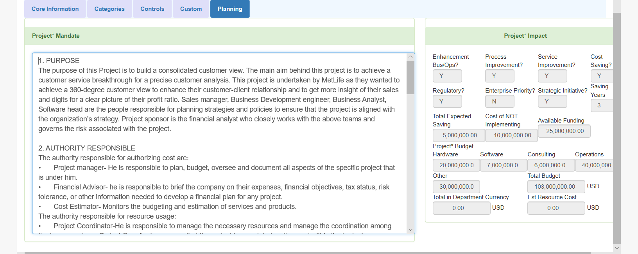
Continued..
STEP 2
Once the project was finalized the next step was project initiation which involved preparing mandate which included the scope, purpose, objective and other related functionalities of the project.

Slide 20
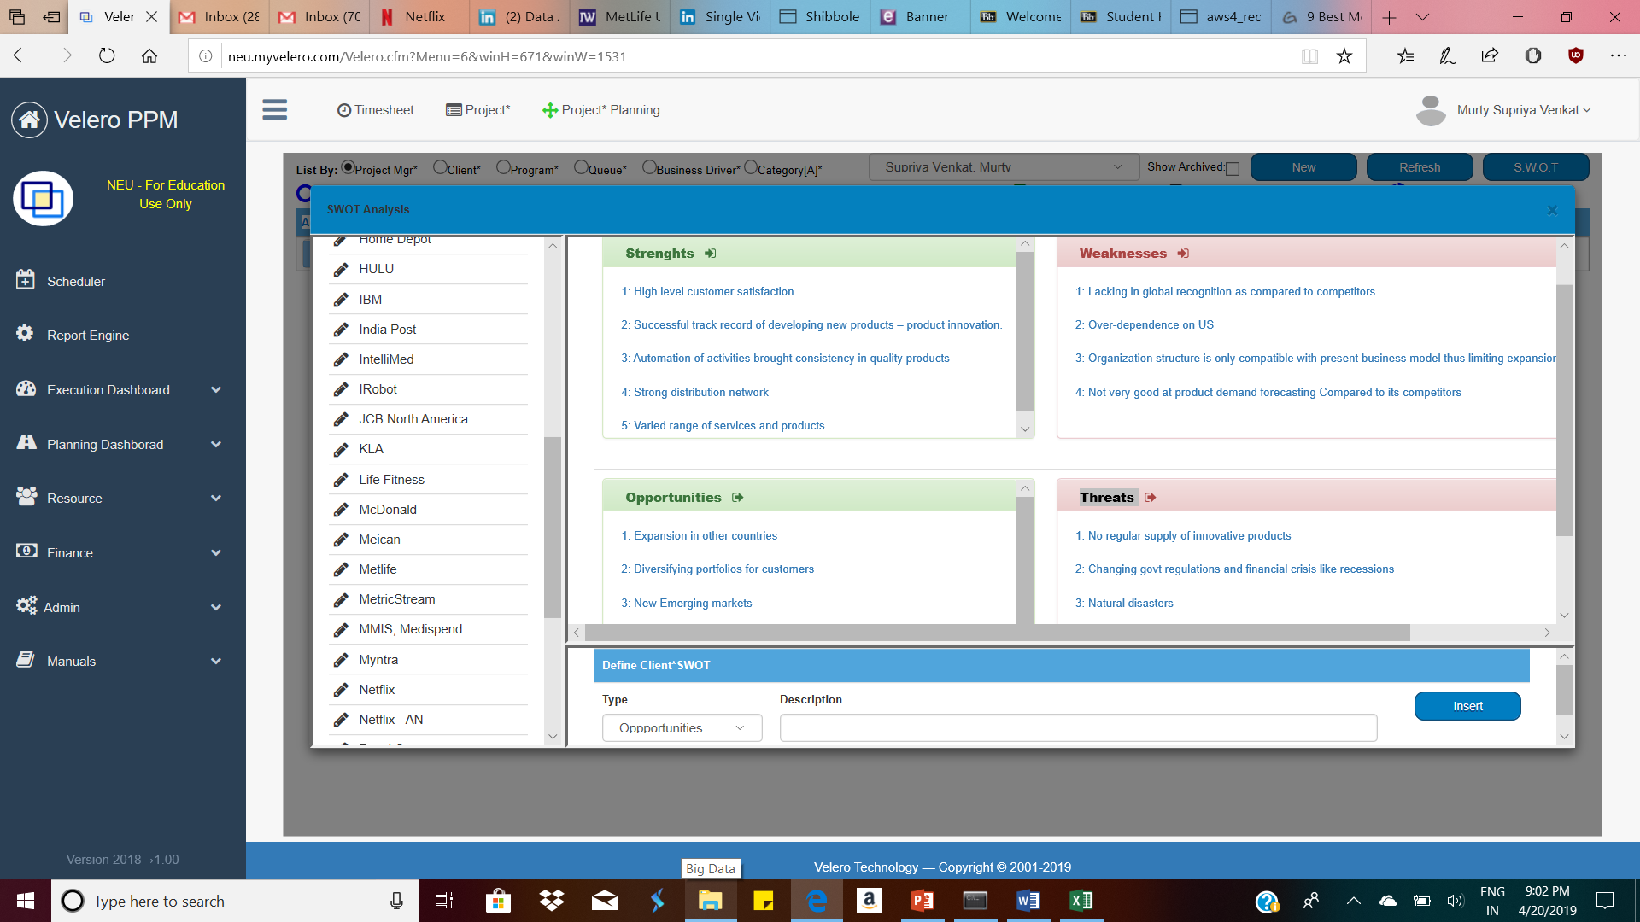
Continued..
STEP 3
After The project initiation the next step was planning which involved SWOT Analysis, Budget and resource allocation, preparation of Gantt chart and timeline sheet.
SWOT ANALYSIS

Slide 21
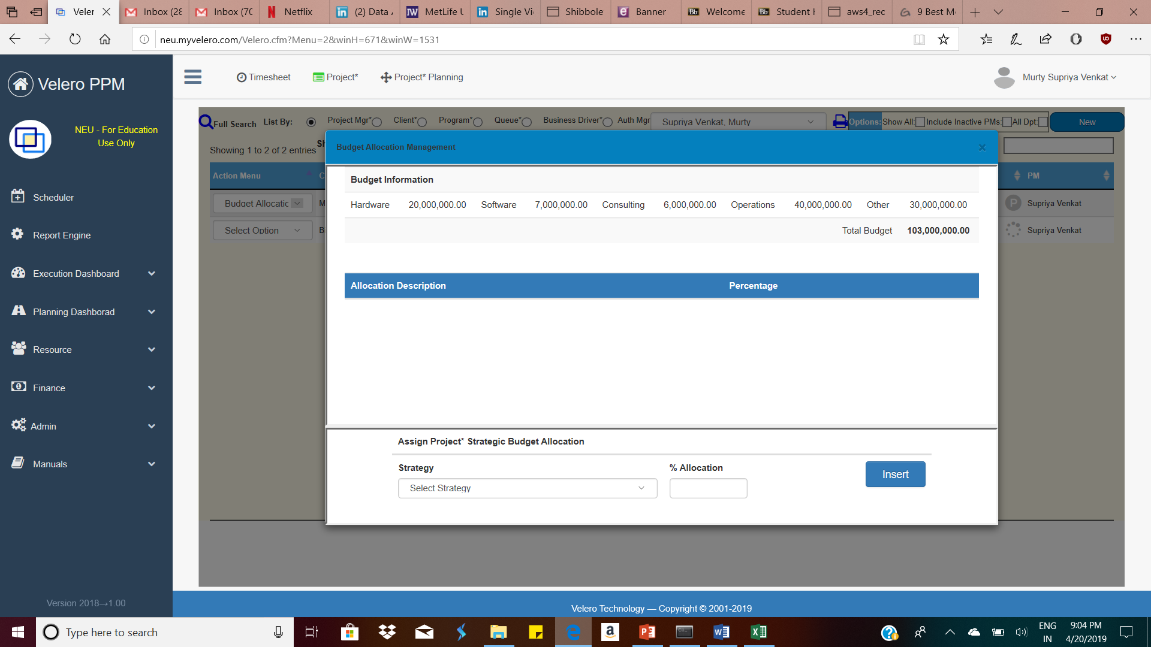
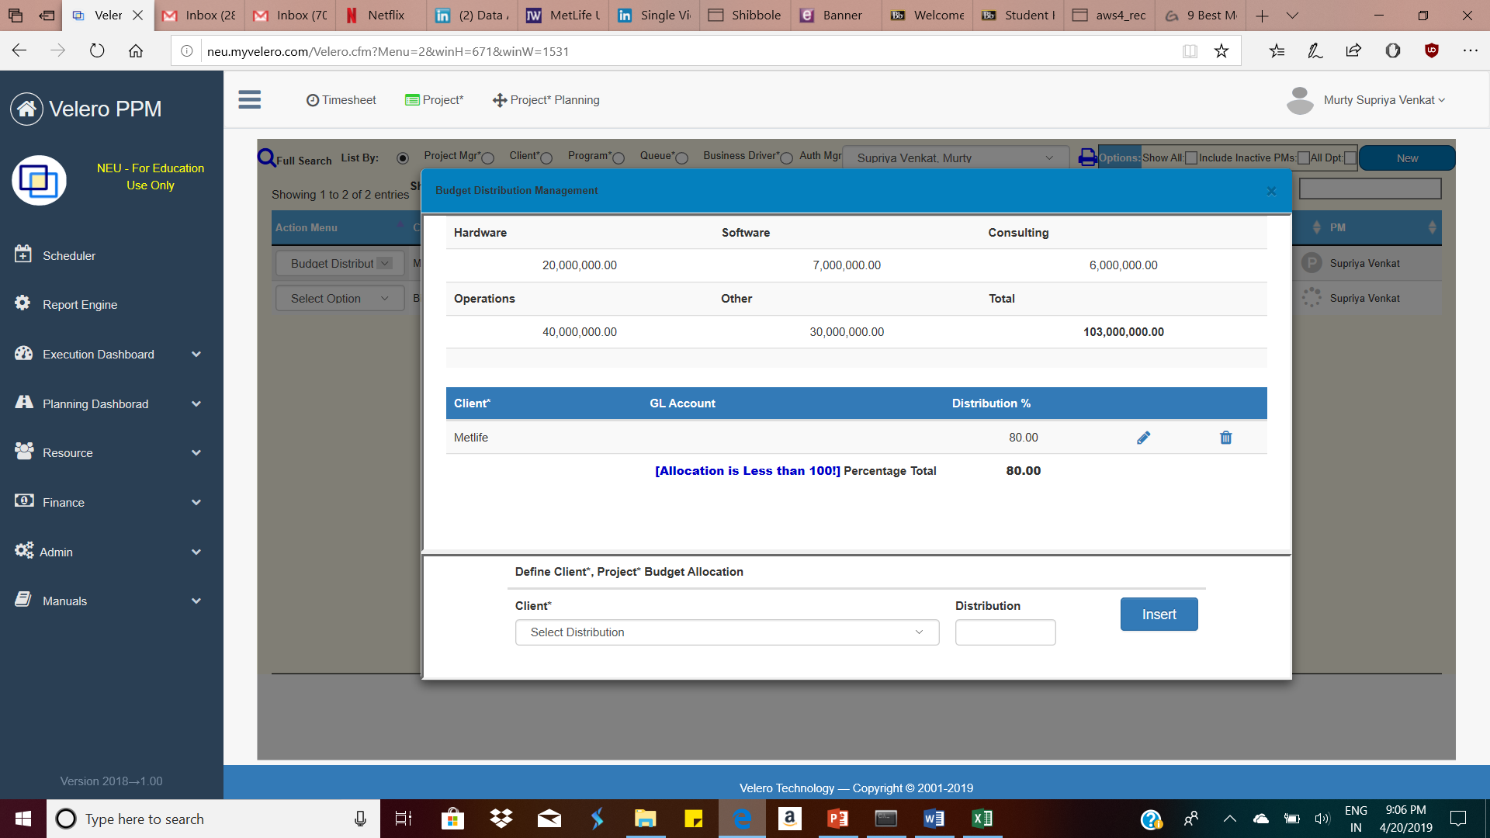
Continued..
BUDGET ALLOCATION
BUDGET DISTRIBUTION

Slide 22
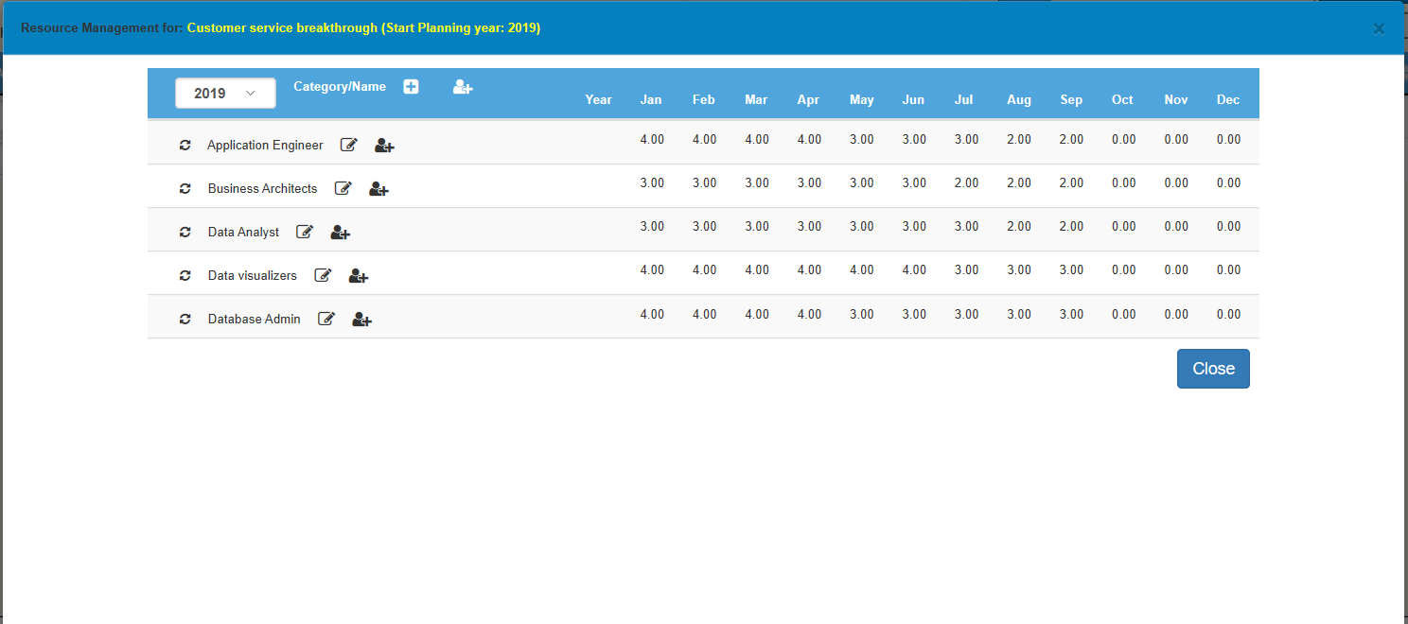
Continued..
RESOURCE ALLOCATION AND MANAGEMENT

Slide 23
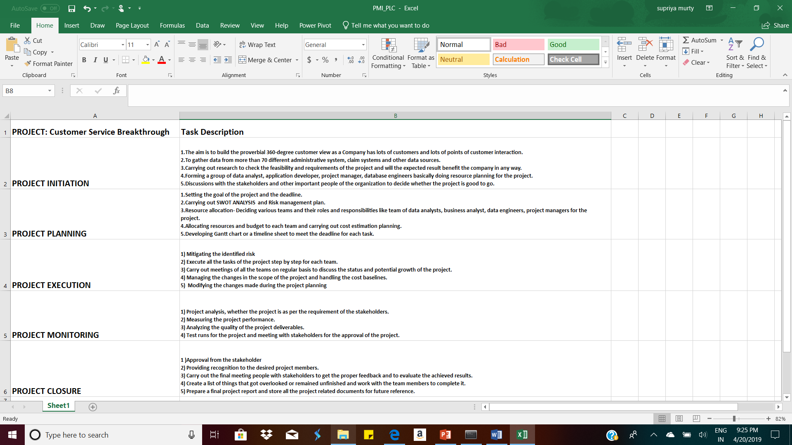
Continued..
STEP 4:
To construct the Vision diagram to identify the data sources and destination and also the data ingestion process.
Step 5:
To write down the steps of Project management life cycle(PMI/PLC Doc.) which includes all the phases of project development from initiation to monitoring and control.

Slide 24
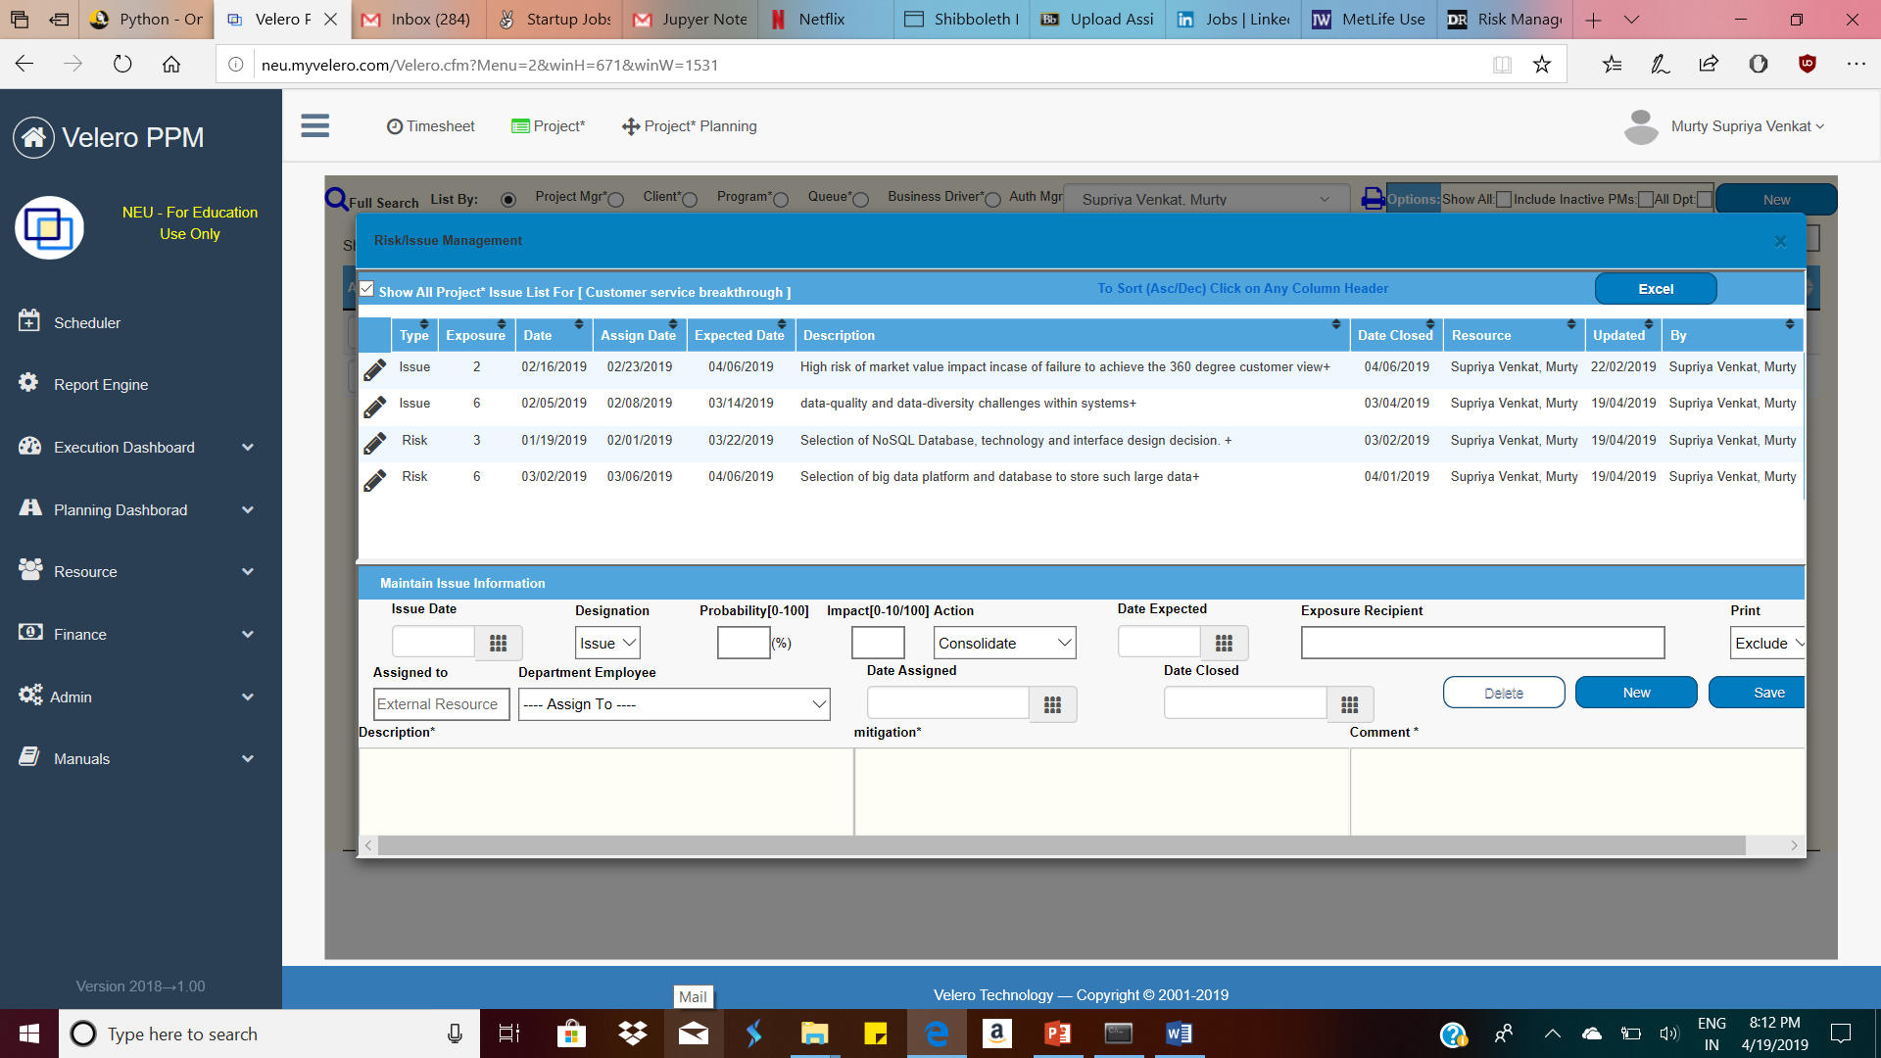
Risk and Issues
Identified Risks and Issues
High risk of market value impact incase of failure to achieve the 360 degree customer view
Data-quality and data-diversity challenges within systems.
Selection of big data platform and database to store such large data
Meeting the deadlines.
Selection of NoSQL Database, technology and interface design decision.

Slide 25
Data Collection and storage
The various data sources from which MetLife gathers data are: Administrative systems, claims systems, data from social media and other relevant data sources..
Most of the data is life insurance and annuity products, but as healthcare and the insurance business have evolved, so, too, have data-collection requirements and standards have changes in a better way.
For storing such a diverse data lead to the selection of MongoDB -- 10Gen's open source document database -- over other NoSQL alternatives such as Cassandra, which MetLife is testing in other applications.
Everything we know about a customer and everything we know about a policy is sored into a single JSON [Java Script Object Notation] document.
Hadoop has two main parts – a data processing framework and a distributed filesystem for data storage.
HDFS can be used for data processing as in the Hadoop architecture as a single NameNode tracks where data is housed in the cluster of servers, known as DataNodes.
Data is stored in data blocks on the DataNodes. HDFS replicates those data blocks, usually 128MB in size, and distributes them so they are replicated within multiple nodes across the cluster.
This will help in simultaneous data processing and storage and fasten the pace of data processing.

Slide 26
Security
Hive v0.7.0 is added integration with Hadoop security. MetLife uses Kerberos authorization support which is being used by Hadoop to provide security. Kerberos allows for mutual authentication between client and server.
Data security can be achieved by imposing Social Security Number Protection Policy. This policy applies to all Social Security numbers collected in the course of MetLife's business. It requires that Social Security numbers be maintained in a secure and confidential manner.
Limiting access only to those who need it to perform their jobs. Employees and service providers may not access or disclose Social Security numbers except as necessary for MetLife's business purposes.
Providing technical, administrative, and physical security measures in place to protect your personal information from unauthorized access and improper use.
Secure Data replication and automatic backup at the tie of failure must be incorporated .
Data encryption must be provided at all the layers to protect it from unauthorized access at all the networks.
Project the data model by enabling high level risk and malware mitigation frameworks and softwares at all the service layers.
Review all security procedures periodically to consider appropriate new technology and updated methods.

Slide 27
Scalability
Scalability is the capability of a system, network, or process to handle a growing amount of work, or its potential to be enlarged in order to accommodate that growth.
For MetLife to achieve the 360 degree consolidated customer view scalability is the utmost priority because it is dealing with customer data across the globe in all the field and emerging it in a single platform.
To handle and accommodate the increase in number of data points, requires intelligent data ingestion that again leverages a distributed data infrastructure to rapidly bring in, unify, and store huge amounts of data.
To handle the increase in the number of transaction we can create scalable data lakes, Data lakes are more agile and flexible than traditional, relational data management systems.
When customer profiles and customer segmentation include an integrated mix of demographic, transaction, environment, behavior and social data attributes, organizations achieve several powerful capabilities.
The data base like MongoDB comes handy as it provides horizontal and vertical scaling through sharding, distributing data across several machines and facilitating high throughput operations with large sets of data.
Vertical Scaling of MongDB involves increasing the capacity of a single server, such as using a more powerful CPU, adding more RAM, or increasing the amount of storage space.

Slide 28
Manageability
Manageability and controls is the key aspect for this project development as over time, many different people will work on the system, and they should all be able to work on it productively.
Monitoring the health of the system and quickly restoring service if it goes into a bad state
Performing complex maintenance tasks, such as moving an application from one platform to another
Providing visibility into the runtime behavior and internals of the system, with good monitoring
Providing good support for automation and integration with standard tools
Avoiding dependency on individual machines (allowing machines to be taken down for maintenance while the system as a whole continues running uninterrupted)
Using high-level programming languages as abstractions that hide machine code, CPU registers, and syscalls. SQL is an abstraction that hides complex on-disk and in-memory data structures, concurrent requests from other clients, and inconsistencies after crashes.
For controls and Evolvability we can make use of Agile working patterns provide a framework for adapting to change.
The Agile community has also developed technical tools and patterns that are helpful when developing software in a frequently changing environment, such as test-driven development (TDD) and refactoring.

